Slide 1
Chapter 6: Process Synchronization

Slide 2
Chapter 6: Process Synchronization
Background
The Critical-Section Problem（临界区问题）
Peterson’s Solution（Peterson解决方案）
Synchronization Hardware（同步硬件）
Semaphores（信号量）
Classic Problems of Synchronization（同步经典问题）
Monitors（管程）
Synchronization Examples
Atomic Transactions

Slide 3
Background
Concurrent access（并发访问） to shared data may result in data inconsistency（数据不一致）
Maintaining data consistency requires mechanisms to ensure the orderly execution of cooperating processes（协作进程顺序执行）

Slide 4
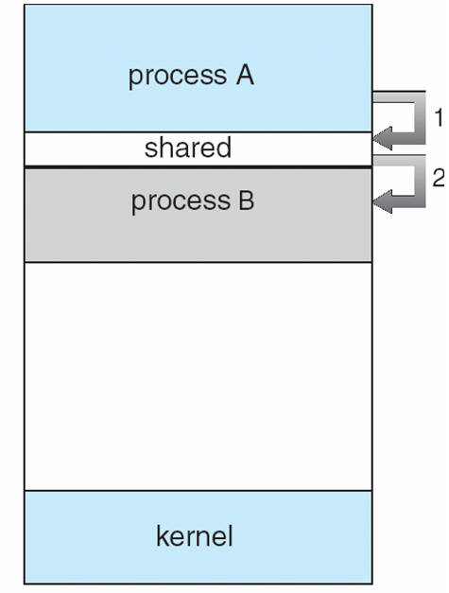
Background
Example： Suppose that we wanted to provide a solution to the consumer-producer problem that fills all the buffers. We can do so by having an integer count that keeps track of the number of full buffers. Initially, count is set to 0. It is incremented by the producer after it produces a new buffer and is decremented by the consumer after it consumes a buffer.

Slide 5
Producer
Producer：
while (true) {
/* produce an item and put in nextProduced*/
while (count == BUFFER_SIZE) ; // do nothing
buffer [in] = nextProduced;
in = (in + 1) % BUFFER_SIZE;
count++;
}

Slide 6
Consumer
Consumer：
while (true) {
while (count == 0)
; // do nothing
nextConsumed= buffer[out];
out = (out + 1) % BUFFER_SIZE;
count--;
/* consume the item in nextConsumed
}
Notes:
6

Slide 7
Race Condition (竞争条件)
count++ could be implemented as register1 = count register1 = register1 + 1 count = register1
count-- could be implemented as register2 = count register2 = register2 - 1 count = register2
4
4
3
3
count
register1
3
3
4
4
register2
count
Notes:
Register是cpu本地寄存器

Slide 8
Race Condition (竞争条件)
Consider this execution interleaving with “count = 3” initially:
P1: producer execute register1 = count {register1 = 3}
P2: producer execute register1 = register1 + 1 {register1 = 4}
C1: consumer execute register2 = count {register2 = 3}
C2: consumer execute register2 = register2 - 1 {register2 = 2}
P3: producer execute count = register1 {count = 4}
C3: consumer execute count = register2 {count = 2}
Producer
Consumer
CPU
r1
r2
count=4
r1:4 r2:0
CPU:
0
3
0
0
4
0
4
3
2
0
P1
P2
P3
2
r1:0 r2:0
Memory:
4
2
3
count=2
count
r1:0 r2:2
C1
C2
C3
Notes:
Register是cpu本地寄存器
并发执行：多个进程在使用同一个cpu，每个进程都独占cpu一会，然后让出cpu资源，供其他进程执行 并行执行：多个进程，在同一时刻，每个进程都有一个cpu进行运算。

Slide 9
Race Condition (竞争条件)
count++ could be implemented as register1 = count register1 = register1 + 1 count = register1
count-- could be implemented as register2 = count register2 = register2 - 1 count = register2
Consider this execution interleaving with “count = 3” initially:
P1: producer execute register1 = count {register1 = 3} P2: producer execute register1 = register1 + 1 {register1 = 4} C1: consumer execute register2 = count {register2 = 3} C2: consumer execute register2 = register2 - 1 {register2 = 2} P3: producer execute count = register1 {count = 4 } C3: consumer execute count = register2 {count = 2}
Notes:
Register是cpu本地寄存器

Slide 10
Race Condition (竞争条件)
What is a race condition?
Several processes access and manipulate the same data concurrently（原因：多个进程同时访问相同数据）
The result of the execution depends on particular access order.（后果：执行结果与执行顺序有关）
To avoid race condition, we need to ensure that only one process at a time can be manipulating the same data.----mutual exclusion(互斥访问)
Notes:
10
race condition竞争条件
若干个并发的进程(线程)都可以访问和操纵同一个共享数据,从而执行结果就取决于并发进程对这个数据的访问次序.
为了保证数据的一致性,需要有同步机制来保证多个进程对共享数据的互斥访问.

Slide 11
Two threads, one counter
Popular web server
Uses multiple threads to speed things up.
Simple shared state error:
each thread increments a shared counter to track number of hits
What happens when two threads execute concurrently?
…
hits = hits + 1;
…
Notes:
11

Slide 12
Shared counters
Possible result: lost update!
⇒ Difficult to debug
Called a “race condition”
hits = 0
T1
T2
time
read hits (0)
read hits (0)
hits = 0 + 1
hits = 0 + 1
hits = 1
Notes:
12

Slide 13
Objectives
To introduce the critical-section(临界区) problem, whose solutions can be used to ensure the consistency of shared data
To present both software and hardware solutions of the critical-section problem（软件和硬件解决方法）
To introduce the concept of an atomic transaction and describe mechanisms to ensure atomicity（原子事务）

Slide 14
Critical-Section (临界区)
Critical resource（临界资源）:
The resource that must be accessed mutual excluded (互斥的).
Critical section（临界区）：
A segment of code in which the process is accessing critical resource
Consider a set of concurrent processes{ P₀,P₁,…,P_{n-1}}.
Each process has a segment of code, called a critical section, in which the process may be changing common variables, updating a table, writing a file, and so on.
Notes:
14

Slide 15
Critical-Section
To ensure the shared data to be modified mutual excluded, no more than one process can execute in its critical section at the same time. （不能有一个以上的进程同时在它的临界区执行）
Each process must request permission to enter its critical section----entry section (进入区)
And exit with the exit section (退出区).
Notes:
15

Slide 16
Solution to Critical-Section Problem
1. Mutual Exclusion 互斥 (safety) - No more than one process can be in a critical section at any time.
2. Progress 有空让进 (liveness) - If no process is executing in its critical section and there exist some processes wishing to enter their critical section, then the selection of the processes that will enter the critical section next cannot be postponed indefinitely
3. Bounded Waiting 有限等待- A bound must exist on the number of times that other processes are allowed to enter their critical sections after a process has made a request to enter its critical section and before that request is granted
Assume that each process executes at a nonzero speed
No assumption concerning relative speed of the N processes
Ideally we would like fairness（公平） as well
If two threads are both trying to enter a critical section, they have equal chances of success
… in practice, fairness is rarely guaranteed
Notes:
互斥(保证安全),有空让进(保证资源的利用率),有限等待(防止饥饿)

Slide 17
Critical Section Goals
Threads do some stuff but eventually might try to access shared data
T1
T2
CSEnter();
Critical section
CSExit();
CSEnter();
Critical section
CSExit();
time
T1
T2
Notes:
17

Slide 18
Critical Section Goals
Perhaps they loop (perhaps not!)
T1
T2
CSEnter();
Critical section
CSExit();
CSEnter();
Critical section
CSExit();
T1
T2
Notes:
18

Slide 19
Solving the problem
A first idea:
Have a boolean flag, inside. Initially false.
Code is unsafe: thread 0 could finish the while test when inside is false, but then 1 might call CSEnter() before 0 can set inside to true!
T0:
T1:
CSEnter()
{
while(inside) continue;
inside = true;
}
#Critical section
CSExit()
{
inside = false;
}
CSEnter()
{
while(inside) continue;
inside = true;
}
#Critical section
CSExit()
{
inside = false;
}
Notes:
19

Slide 20
Solving the problem: Take 2
A different idea (assumes just two threads):
Have a boolean flag, inside[i]. Initially false.
Code isn’t live: with bad luck, both threads could be looping, with 0 looking at 1, and 1 looking at 0
T0:
T1:
CSEnter(int i)
{
inside[i] = true;
while(inside[j]) continue;
}
#Critical section
CSExit(int i)
{
Inside[i] = false;
}
CSEnter(int j)
{
inside[j] = true;
while(inside[i]) continue;
}
#Critical section
CSExit(int j)
{
Inside[j] = false;
}
Notes:
20
^ 异或 两个位相同为0，相异为1

Slide 21
Solving the problem: Take 3
Another broken solution, for two threads
Have a turn variable, turn, initially 1.
Code isn’t live: thread 1 can’t enter unless thread 0 did first, and vice-versa. But perhaps one thread needs to enter many times and the other fewer times, or not at all
T0:
T1:
CSEnter(int i)
{
while(turn != i) continue;
}
#Critical section
CSExit(int i)
{
turn = j;
}
Other processing…
Notes:
21
限制两个线程交替进入临界区, ^也可以表示特殊的二元运算符——逐位逻辑运算符（用于对数据的位进行操作），它表示的含义是逐位非或，要求两个整型操作数。从最小（即最右）的位开始，对操作数逐位操作；如果只有其中一个位为1，那么结果为1；否则为0。

Slide 22
Solving the problem
小结 Three points：
1. 线程是否请求访问该临界资源（想不想访问）？
2. 临界资源是否没有任何线程正在访问（能不能访问）？
3. 如果临界资源能够访问，如何让所有线程不发生歧义地
得知自己接下来能否访问？（唯一性标识）

Slide 23
Solving the problem : Take 1
A first idea:
Have a boolean flag, inside. Initially false.
Code is unsafe: thread 0 could finish the while test when inside is false, but then 1 might call CSEnter() before 0 can set inside to true!
T0:
T1:
CSEnter()
{
while(inside) continue;
inside = true;
}
#Critical section
CSExit()
{
inside = false;
}
CSEnter()
{
while(inside) continue;
inside = true;
}
#Critical section
CSExit()
{
inside = false;
}
唯一性标识
Notes:
23

Slide 24
Solving the problem: Take 2
A different idea (assumes just two threads):
Have a boolean flag, inside[i]. Initially false.
Code isn’t live: with bad luck, both threads could be looping, with 0 looking at 1, and 1 looking at 0
T0:
T1:
CSEnter(int i)
{
inside[i] = true;
while(inside[j]) continue;
}
#Critical section
CSExit(int i)
{
Inside[i] = false;
}
CSEnter(int j)
{
inside[j] = true;
while(inside[i]) continue;
}
#Critical section
CSExit(int j)
{
Inside[j] = false;
}
能不能访问
Notes:
24

Slide 25
Solving the problem: Take 3
Another broken solution, for two threads
Have a turn variable, turn, initially 1.
Code isn’t live: thread 1 can’t enter unless thread 0 did first, and vice-versa. But perhaps one thread needs to enter many times and the other fewer times, or not at all
T0:
T1:
CSEnter(int i)
{
while(turn != i) continue;
}
#Critical section
CSExit(int i)
{
turn = i ^ 1;
}
Other processing…
想不想访问
Notes:
25
限制两个线程交替进入临界区, ^也可以表示特殊的二元运算符——逐位逻辑运算符（用于对数据的位进行操作），它表示的含义是逐位非或，要求两个整型操作数。从最小（即最右）的位开始，对操作数逐位操作；如果只有其中一个位为1，那么结果为1；否则为0。

Slide 26
Objectives
To introduce the critical-section(临界区) problem, whose solutions can be used to ensure the consistency of shared data
To present both software and hardware solutions of the critical-section problem
To introduce the concept of an atomic transaction and describe mechanisms to ensure atomicity

Slide 27
Peterson’s Solution
A classic software-based solution to the critical section problem.
Works for two processes.
The two processes share two variables:
int turn：indicates whose turn it is to enter the critical section. (唯一性标识、能不能访问)
Boolean flag[2]：The flag array is used to indicate if a process is ready to enter the critical section. flag[i] = true implies that process P_{i} is ready! (想不想访问)

Slide 28
Peterson’s Algorithm
“礼貌的Peterson”
Pi Pj
进程Pi与Pj共享两个参数：
flag[]; (想不想访问)
turn; (唯一性标识；能不能访问)
思考：
如果不是只有两个进程呢？程序中需要改动吗？
如果要改动，改动哪里？
Notes:
要求两个进程共享两个数据项flag和turn
改动：turn=turn+1

Slide 29
Dekker Algorithm
Set flag[]=false; turn=0;
do{
flag[i]=true;
while flag[j]==true{
if turn !=i{
flag[i]=false;
while (turn != i);
flag[i] =true;
}
}
}
临界区
turn=1;
flag[i]=false;
“举手放手的Dekker”

Slide 30
Objectives
To introduce the critical-section(临界区) problem, whose solutions can be used to ensure the consistency of shared data
To present both software and hardware solutions of the critical-section problem
To introduce the concept of an atomic transaction and describe mechanisms to ensure atomicity

Slide 31
Synchronization Hardware
Many systems provide hardware support for critical section code.（许多系统为临界区代码提供硬件支持）
Hardware features can make programming task easier and improve system efficiency.（优点：简化编程任务，提高系统效率）
Modern machines provide special atomic hardware instructions to solve critical section problem in a relatively simple manner.
Atomic (原子)= non-interruptable
通过特殊的内存访问电路
针对单处理器和多处理器

Slide 32
Solution to Critical-section Problem Using Locks
In general, any solution to critical-section requires a lock (锁) in order to prevent race condition.
do {
Acquire lock
#critical section
Release lock
#remainder section
} while (true)
Two atomic algorithms:
TestAndSet
Swep

Slide 33
Solution 1: TestAndSet Instruction
Definition:
boolean TestAndSet (boolean *target)
{
boolean rv = *target;
*target = TRUE;
return rv:
}

Slide 34
Solution using TestAndSet
Shared boolean variable lock, initialized to false.
Notes:
在进入区利用TS进行检查：有进程在临界区时，重复检查；直到其它进程退出时，检查通过；
在退出区置lock为FALSE

Slide 35
Solution using TestAndSet
Shared boolean variable lock, initialized to false.
while (true) {
while ( TestAndSet (&lock ))
; /* do nothing
// critical section
lock = FALSE;
// remainder section
}
boolean TestAndSet (boolean *target)
{
boolean rv = *target;
*target = TRUE;
return rv;
}
false

Slide 36
Solution 2: Swap Instruction
Definition:
void Swap (boolean *a, boolean *b)
{
boolean temp = *a;
*a = *b;
*b = temp;
}

Slide 37
Solution using Swap
Shared Boolean variable lock initialized to FALSE; Each process has a local Boolean variable key.

Slide 38
Solution using Swap
Shared Boolean variable lock initialized to FALSE; Each process has a local Boolean variable key.
Solution:
while (true) {
key = TRUE;
while ( key == TRUE)
Swap (&lock, &key );
// critical section
lock = FALSE;
// remainder section
}

Slide 39
忙等待和无忙等待
忙等待
AcquireLoc(){
while(TestandSet(&lock))
}
临界区
Release(){
*lock=false;
}

Slide 40
忙等待和无忙等待
无忙等待
AcquireLoc(){
while(TestandSet(&lock))
add this TCB to wait queue q;
}
临界区
Release() (){
*lock=false;
remove one thread t from q;
wakeup(t)
}

Slide 41
原子操作优点
适用于单处理器或者共享主存的多处理器中任意数量的进程。
简单并且容易证明
可以用于支持多临界区

Slide 42
原子操作的缺点
忙等待消耗处理器时间
当进程离开临界区并且多个进程在等待的时候可能导致饥饿
死锁：
如果一个低优先级的进程拥有临界区，但同时一个高优先级进程也有需求，那么高优先级进程会获得处理器，但不得不等待临界区

Slide 43
禁用中断
没有中断，没有上下文切换，因此没有并发
硬件将中断处理延迟到中断被启用之后
大多数现代计算机体系结构都提供指令来完成
进入临界区
禁用中断
离开临界区
开启中断

Slide 44
禁用中断缺点
一旦中断被禁用,线程就无法被停止
整个系统都会为该线程停下来
可能导致其他线程处于饥饿状态
如果临界区可以任意长：
无法限制响应中断所需的时间
只能禁用该CPU自己的中断指令，无法控制其他CPU的中断指令，仍然存在隐患

Slide 45
An example
当队列中有n个进程p0,p2,...pn-1,如何管理他们的临界区？用原语写出一段访问临界资源的代码。
do {
waiting[i]=true;
key = true;
while (waiting[i] && key)
key=TestAndSet (&lock);
// critical section
j=(i+1) % n;
while((j != i)) && !waiting[j]
j=(j+1) % n;
if(j == i)
lock=false;
else
waiting[j]=false;
}while(true)
(想不想访问)
(唯一性标识)
(能不能访问)

Slide 46
临界区小结
锁是解决临界区问题的常用方法：
互斥可以使用锁来实现
通常需要一定等级的硬件支持
常用的三种实现方法：
禁用中断（仅限于单处理器）
软件方法（复杂）
硬件方法（原子操作指令，单处理器或多处理器均可）
可选的实现内容：
有忙等待
无忙等待

Slide 47
本节小结
Background (race condition, 竞争条件)
The Critical-Section Problem (临界区问题)
Peterson’s Solution (software-based)
Synchronization Hardware (hardware-based: automic)
Semaphores
Classic Problems of Synchronization
Monitors
Synchronization Examples
Atomic Transactions

Slide 48
习题
1. 操作系统中有一组常称为特殊系统调用的程序，它不能被系统中断，在操作系统中称为（）
A 初始化程序
C 子程序
D 控制模块
B 原语

Slide 49
习题
2. 在一段时间内，只允许一个进程访问的资源称为（）
A 共享资源
B 临界区
D 共享区
C 临界资源

Slide 50
习题
3. 临界区是指并发进程中访问共享变量的（）段
A 管理信息
B 信息存储
D 数据
C 程序

Slide 51
例题
【多选】在单处理机系统中，设系统中有n个进程（n>2）,且当前处理机没有执行进程调度程序，下述情况哪些可能发生（ ）。
A.没有运行的进程，有2个进程处于就绪状态，n个进程处于等待状态。
B.一个进程处于运行状态，n-1个进程处于等待状态
C. 一个进程处于运行状态，1个进程处于就绪状态，n-2个进程处于等待状态。
D. 一个进程处于运行状态，n-1个进程处于就绪状态，没有进程处于等待状态
答案： BCD

Slide 52
Chapter 6: Process Synchronization
Background
The Critical-Section Problem
Peterson’s Solution
Synchronization Hardware
Semaphores
Classic Problems of Synchronization
Monitors
Synchronization Examples
Atomic Transactions

Slide 53
Semaphore
A Semaphore is a special integer variable（特殊的整数变量）, it can be accessed only through two standard atomic operations:
Wait() and Signal()
Originally called P() and V()
Wait(S) {
while S <= 0
; // busy wait
S--;
}
signal (S) {
S++;
}

Slide 54
Semaphore Implementation
The main disadvantage of the above semaphore definition is busy waiting which wastes CPU cycles.
Spinlock（自旋锁）
Process spins while waiting for the lock.
In a multiprocessor system, spinlock is often used to protect a short code.（通常用于保护短代码）
Note that applications may spend lots of time in critical sections and therefore this is not a good solution.（不是一个好的解决方案）
Notes:
自旋锁：一直占用 CPU 的时间片去循环获取锁，直到获取到为止。
非自旋锁：当前线程进入阻塞，CPU 可以去干别的事情。等待 CPU 唤醒了，线程才去获取非自旋锁。

Slide 55
Semaphore Implementation with no Busy waiting
To overcome busy waiting, we can modify the implementation of semaphore S and the definition of wait() and signal(). （修改wait()和signal()的定义）
Now that a semaphore is a struct.
a value (of type integer)
a waiting queue
Two operations:
block – place the process invoking the operation on the appropriate waiting queue.
wakeup – remove one of processes in the waiting queue and place it in the ready queue.

Slide 56
Semaphore Implementation with no Busy waiting (Cont.)
Implementation of wait:
wait (S){
value--;
if (value < 0) {
add this process to waiting queue
block(); }
}
Implementation of signal:
Signal (S){
value++;
if (value <= 0) {
remove a process P from the waiting queue
wakeup(P); }
}

Slide 57
Semaphore as General Synchronization Tool
Counting semaphore
integer value can range over an unrestricted domain
Can be used to control access to a given resource consisting of a finite number of instances.
Binary semaphore
integer value can range only between 0 and 1; can be simpler to implement
Also known as mutex locks（互斥锁）
Provides mutual exclusion
Semaphore S; // initialized to 1
wait (S);
Critical Section
signal (S);

Slide 58
Deadlock and Starvation
The implementation of a semaphore with a waiting queue may result in one of the two following situations.（导致死锁和饥饿）
Deadlock（死锁） – two or more processes are waiting indefinitely for an event that can be caused by only one of the waiting processes
Let S and Q be two semaphores initialized to 1
P₀ P₁
wait (S); wait (Q);
wait (Q); wait (S);
. .
. .
. .
signal (S); signal (Q);
signal (Q); signal (S);
Starvation（饥饿） – indefinite blocking. A process may never be removed from the semaphore queue in which it is suspended.

Slide 59
Deadlock and Starvation
The implementation of a semaphore with a waiting queue may result in one of the two following situations.
Deadlock – two or more processes are waiting indefinitely for an event that can be caused by only one of the waiting processes
Let S and Q be two semaphores initialized to 1
P₀ P₁
wait (S); wait (Q);
wait (Q); wait (S);
. .
. .
. .
signal (S); signal (Q);
signal (Q); signal (S);

Slide 60
Deadlock and Starvation
The implementation of a semaphore with a waiting queue may result in one of the two following situations.
Deadlock – two or more processes are waiting indefinitely for an event that can be caused by only one of the waiting processes
Let S and Q be two semaphores initialized to 1
P₀ P₁
wait (S); wait (Q);
wait (Q); wait (S);
. .
. .
. .
signal (S); signal (Q);
signal (Q); signal (S);

Slide 61
Deadlock and Starvation
The implementation of a semaphore with a waiting queue may result in one of the two following situations.
Deadlock – two or more processes are waiting indefinitely for an event that can be caused by only one of the waiting processes
Let S and Q be two semaphores initialized to 1
P₀ P₁
wait (S); wait (Q);
wait (Q); wait (S);
. .
. .
. .
signal (S); signal (Q);
signal (Q); signal (S);
Starvation – indefinite blocking. A process may never be removed from the semaphore queue in which it is suspended.

Slide 62
AND Semaphore
Swait(S1, S2, …, Sn)
{
while (TRUE)
{
if (S1 >=1 && S2 >= 1 && … && Sn >= 1)
{
for (i = 1; i <= n; ++i) --Si;
break;
}
else
{ add the process to Sj.queue //no available resource to use and S_{j} is the first semaphore of which value is less than 1 ;
block();
}
}
}

Slide 63
AND Semaphore
Ssignal(S1, S2, …, Sn)
{
for (i = 1; i <= n; ++i)
{
++Si; //release resources；
for (each process P waiting in Si.queue)
//check if there is some process waiting；
{
remove a process P from Si.queue;
if (Swait(S1, S2, …, Sn) )
//different from signal, P will be waken up when it acquires all resources ；
{ //all needed resources are available；
wakeup(P);
}
else
{ //otherwise；
add process P to another waiting queue；
}
}
}
}

Slide 64
(互斥）Mutual exclusion using semaphore
Semaphore mutex ; // initialized to 1

Slide 65
（同步）Synchronization using semaphore
Consider two concurrently running processes P1 and P2, P1 with a statement C1 and P2 with a statement C2. suppose we require that C2 be executed only after C1 has completed
We can define a common semaphore S12, initialized to 0.
Notes:
65

Slide 66
Example 1
S₂
d
a
e
S₅
h
b
j
S₁
S₃
S₇
S₈
f
i
c
S₆
g
S₄

Slide 67
Struct
smaphore a,b,c,d,e,f,g,h,I,j=0,0,0,0,0,0,0,0,0,0
cobegin
{S1;V(a);V(b);V(c);}
{P(a);S2;V(d);}
{P(b);S3;V(e);V(f);}
{P(c);S4;V(g);}
{P(d);P(e);S5;V(h);}
{P(f);P(g);S6;V(i)}
{P(h);P(i);S7;V(j);}
{P(j);S8;}
coend
S₂
d
a
h
e
S₅
S₁
b
j
S₃
f
S₇
S₈
i
c
S₆
g
S₄

Slide 68
Example 2
（A²+3B）/(B+5A),若A,B已赋值，
试画出该公式求值过程的前趋图。

Slide 69
开始
S1:x1=A*A
S2:x2=3*B
S3:x3=5*A
S4:x4=x1+x2
S5:x5=B+x3
S₁
S₂
S₃
S6:x6=x4/x5
结束
S₄
S₅
（A²+3B）/(B+5A)
S₆

Slide 70
Chapter 6: Process Synchronization
Background
The Critical-Section Problem
Peterson’s Solution
Synchronization Hardware
Semaphores
Classic Problems of Synchronization
Monitors
Synchronization Examples
Atomic Transactions

Slide 71
Classical Problems of Synchronization
Bounded-Buffer Problem（有界缓冲问题）
Readers and Writers Problem（读者-作者问题）
Dining-Philosophers Problem（哲学家就餐问题）

Slide 72

Bounded-Buffer Problem
Problem:
producer puts things into a shared buffer
Consumer takes them out
Need synchronization for coordinating producer and consumer

Slide 73

Bounded-Buffer Problem
Coke machine example:
delivery person (producer) fills machine with cokes
students (consumer) feed cokes and drink them
coke machine has finite space (buffer)

Slide 74
Producer-Consumer Problem
Bounded buffer: size ‘N’
Access entry 0… N-1, then “wrap around” to 0 again
Producer process writes data to buffer
Must not write more than ‘N’ items more than consumer “ate”
Consumer process reads data from buffer
Should not try to consume if there is no data
0
1
N-1
In
Out
Notes:
74

Slide 75
Bounded-Buffer Problem
N buffers, each can hold one item
Semaphore mutex initialized to the value 1
Semaphore full initialized to the value 0
Semaphore empty initialized to the value N.

Slide 76
The structure of Producer/Consumer process

Slide 77
Bounded Buffer Problem (Cont.)
The structure of the producer process
while (true) {
// produce an item
wait (empty);
wait (mutex);
// add the item to the buffer
signal (mutex);
signal (full);
}

Slide 78
Bounded Buffer Problem (Cont.)
The structure of the consumer process
while (true) {
wait (full);
wait (mutex);
// remove an item from buffer
signal (mutex);
signal (empty);
// consume the removed item
}

Slide 79
Bounded-Buffer Problem
public class BoundedBuffer {
public BoundedBuffer() { /* see next slides */ }
public void enter() { /* see next slides */ }
public Object remove() { /* see next slides */ }
private static final int BUFFER_SIZE = 2;
private Semaphore mutex;
private Semaphore empty;
private Semaphore full;
private int count, in, out;
private Object[] buffer;
}

Slide 80
Bounded Buffer Constructor
public BoundedBuffer() {
// buffer is initially empty
count = 0;
in = 0;
out = 0;
buffer = new Object[BUFFER_SIZE];
mutex = new Semaphore(1);
empty = new Semaphore(BUFFER_SIZE);
full = new Semaphore(0);
}

Slide 81
enter() Method
public void enter(Object item) {
empty.P();
mutex.P();
// add an item to the buffer
++count;
buffer[in] = item;
in = (in + 1) % BUFFER_SIZE;
mutex.V();
full.V();
}

Slide 82
remove() Method
public Object remove() {
full.P();
mutex.P();
// remove an item from the buffer
- - count;
Object item = buffer[out];
out = (out + 1) % BUFFER_SIZE;
mutex.V();
empty.V();
return item;
}

Slide 83
What’s wrong?
Init: Semaphore mutex = 1; /* for mutual exclusion*/
Semaphore empty = N; /* number empty buf entries */
Semaphore full = 0; /* number full buf entries */
any_t buf[N];
int tail = 0, head = 0;
Oops! Even if you do the correct operations, the order in which you do semaphore operations can have an incredible impact on correctness
Producer
void put(char ch) {
wait(mutex);
wait (empty);
// add ch to buffer
buf[head%N] = ch;
head++;
signal(mutex);
signal (full );
}
Consumer
char get() {
wait (full );
wait (mutex);
// remove ch from buffer
ch = buf[tail%N];
tail++;
signal (mutex);
signal (empty);
return ch;
}
What if buffer is full?
Notes:
83

Slide 84
Discussion about Bounded Buffer Solution
Why asymmetry（不对称）?
Producer does: wait (empty), signal(full)
Consumer does: wait (full), signal(empty)
Is order of wait ’s important?
Yes! Can cause deadlock
Is order of signal’s important?
No, except that it might affect scheduling efficiency
What if we have 2 producers or 2 consumers?
Do we need to change anything?
Notes:
84
不用改变

Slide 85
Readers-Writers Problem
W
R
R
R
Motivation: Consider a shared database
Two classes of users:
Readers – never modify database
Writers – read and modify database
85
Notes:
85

Slide 86
Readers-Writers Problem
Problem – allow multiple readers to read at the same time. Only one single writer can access the shared data at the same time.
Shared Data
Data set
Semaphore Rmutex initialized to 1.
Semaphore Wmutex initialized to 1.
Integer readcount initialized to 0.

Slide 87
Readers-Writers Problem
Notes:
Rmutex保护的是Rcount
Wmutex保护的是互斥资源

Slide 88
The structure of the Writer/Reader process(con.)
Shared variables: Semaphore mutex, wrl;
integer readcount;
Init: mutex = 1, wrl = 1, readcount = 0;
Writer
do {
wait(wrl);
. . .
/*writing is performed*/
. . .
signal(wrl);
}while(TRUE);
Reader
do {
wait (mutex);
readcount++;
if (readcount == 1) wait (wrl);
signal(mutex);
. . .
/*reading is performed*/
. . .
wait (mutex);
readcount--;
if (readcount == 0) signal(wrl);
signal(mutex);
}while(TRUE);
Notes:
88

Slide 89
Readers-Writers Problem: Reader
public class Reader extends Thread {
public Reader(Database db) {
server = db;
}
public void run() {
int c;
while (true) {
c = server.startRead();
// now reading the database
c = server.endRead();
}
}
private Database server;
}

Slide 90
Readers-Writers Problem (cont)
public class Database
{
public Database() {
readerCount = 0;
mutex = new Semaphore(1);
db = new Semaphore(1);
}
public int startRead() { /* see next slides */ }
public int endRead() { /* see next slides */ }
public void startWrite() { /* see next slides */ }
public void endWrite() { /* see next slides */ }
private int readerCount; // number of active readers
Semaphore mutex; // controls access to readerCount
Semaphore db; // controls access to the database
}

Slide 91
startRead() Method
public int startRead() {
mutex.P();
++readerCount;
// if I am the first reader tell all others
// that the database is being read
if (readerCount == 1)
db.P();
mutex.V();
return readerCount;
}

Slide 92
endRead() Method
public int endRead() {
mutex.P();
--readerCount;
// if I am the last reader tell all others
// that the database is no longer being read
if (readerCount == 0)
db.V();
mutex.V();
return readerCount;
}

Slide 93
Writer Methods
public void startWrite() {
db.P();
}
public void endWrite() {
db.V();
}

Slide 94
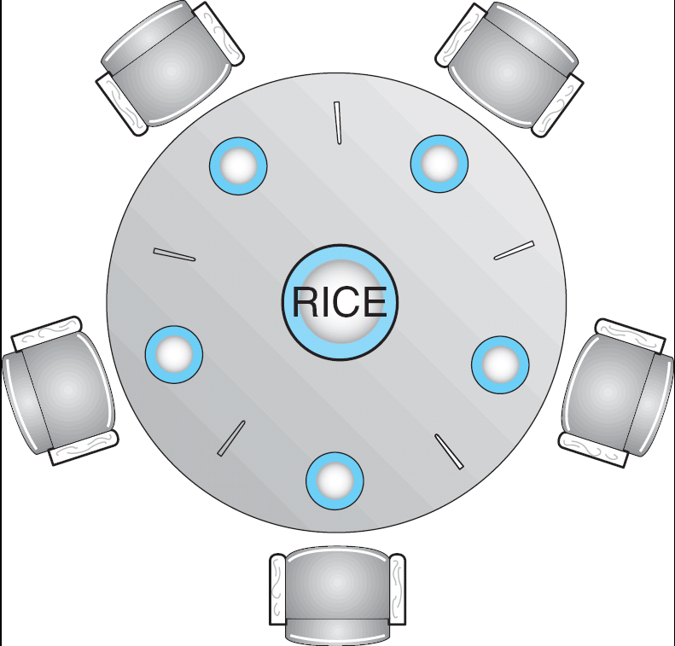
Dining-Philosophers Problem
Shared data
Bowl of rice (data set)
Semaphore chopstick [5] initialized to 1

Slide 95
Dining-Philosophers Problem (Cont.)
The structure of Philosopher i:
While (true) {
wait ( chopstick[i] );
wait ( chopStick[ (i + 1) % 5] );
// eat
signal ( chopstick[i] );
signal (chopstick[ (i + 1) % 5] );
// think
}
Deadlock?

Slide 96
Solution2：AND semaphore
Var chopstick array[0,…,4] of semaphore :=(1,1,1,1,1);
Processi
Reeat
think;
Swait (chopstick[(I+1) mod 5],chopstick[I]);
Eat;
Ssignal (chopstick[(I+1) mod 5],chopstick[I]);
Until false;

Slide 97
Discussion about Semaphores
The value of a semaphore represents the number of available resource
S>0: there are S available resources
S=0: all resources are being used
S<0: there are |S| processes waiting for the resource
Operations can be done to a semaphore S:
Initialization: >=0
Wait(): request a resource
signal (): release a resource
Notes:
97

Slide 98
Discussion about Semaphores( Cont.)
Either wait(S) or signal(S) can not be omitted
For mutual exclusion: they appear in the same process（互斥在一边）
For synchronization: they appear in different process respectively （同步分两边）
For two successive wait(S1) and wait(S2) in a process, the order is important. If S1 is for synchronization, and S2 is for mutual exclusion, then
The correct order is wait(S1) ; wait(S2)
If they are written in the order wait(S2) ;wait(S1) , there would be a deadlock.
Notes:
98

Slide 99
Tips
互斥/同步的对象是谁？
互斥访问什么？
同步什么内容？
Notes:
99

Slide 100
例题
进程之间存在哪几种相互制约关系？各是什么原因引起的？下列活动分别属于哪种制约关系？
（1）若干同学去图书馆借书
（2）流水线生产的各道工序
（3）商品生产和社会消费
答案：
（1）互斥：图书馆的书；
（2）同步：各道工序间同步
（3）同步：先生产，再消费；

Slide 101
例题：工厂分配问题
工厂装配问题
某工厂有两个生产车间和一个装配车间，两个生产车间分别生产A，B两种零件，装配车间的任务是把A,B两种零件组装成产品。两个生产车间每生产一个零件后，都要分别把它们送到专配车间的货架F, F2上。F1存放零件A，F2存放零件B，F1和 F2的容量均可存放10个零件。装配工人每次从货架上取一个零件A和一个零件B后组装成产品。请用 P,V操作进行正确管理。

Slide 102
例题：工厂分配问题
分析：哲学家问题+生产者消费者问题的变种
互斥/同步的对象是谁？
生产者：生产车间A、生产车间B
消费者：装配车间
互斥访问什么？
货架F1、F2
同步什么内容？
先生产，再装配
货架F1上零件A的数量
货架F2上零件B的数量
解答：设置6个信号量：
m1=1, m2=1实现货架F1、F2的互斥使用
empty_1=10, full_1=0 表示货架F1上零件A的数量情况
empty_2=10, full_2=0 表示货架F2上零件B的数量情况
Notes:
102

Slide 103
例题：工厂分配问题
生产车间A：
P（empty_1）
P(m1)
将A零件放到货架F1上；
V(m1)
V(full_1)
装配车间：
P（ full_1 ）
P（ full_2）
P(m1) &P(m2)
将A、B零件组装起来；
V(m1)
V(m2)
V(full_2)
V(full_1)
生产车间B：
P（empty_2）
P(m2)
将B零件放到货架F1上；
V(m2)
V(full_2)

Slide 104
例题：吃水果问题
吃水果问题
桌上有一只盘子，每次只能放一个水果，爸爸向盘中放苹果或桔子，儿子专等吃盘里的桔子，女儿专等吃盘里的苹果。只要盘子空，则爸爸可向盘中放水果，仅当盘中有自己需要的水果时，儿子或女儿可从中取出.
请给出三人之间的同步关系，并用P、V操作实现三人正确活动的程序。

Slide 105
例题：吃水果问题
分析:此问题实际上是生产者-消费者问题的一个变形
互斥/同步的对象是谁？
生产者: 爸爸
消费者：女儿、儿子
互斥访问什么？
缓冲区：盘子
同步什么内容？
苹果个数、桔子个数
解答：设置3个信号量：
mutex=1,实现盘子的互斥使用
empty=1, apple=0,orange=0; 盘子里空位个数；苹果个数；桔子个数

Slide 106
例题：吃水果问题
儿子：P(orange )
P(mutex)
从盘中取桔子；
V(mutex)
V（ empty ）
吃桔子
爸爸：
P（empty)
P(mutex)
将水果放入盘中；
IF桔子 V（orange）
else V（apple）
V(mutex)
女儿： P (apple)
P(mutex)
从盘中取苹果;
V(mutex)
V（ empty ）
吃苹果

Slide 107
Chapter 6: Process Synchronization
Background
The Critical-Section Problem
Peterson’s Solution
Synchronization Hardware
Semaphores
Classic Problems of Synchronization
Monitors
Synchronization Examples
Atomic Transactions

Slide 108
Monitors
A high-level abstraction that provides a convenient and effective mechanism for process synchronization
Only one process may be active within the monitor at a time
monitor monitor-name
{
// shared variable declarations
procedure P1 (…) { …. }
…
procedure Pn (…) {……}
Initialization code ( ….) { … }
…
}
}

Slide 109
Monitors
管程定义：一个管程定义了一个数据结构和能为并发进程调用的在该数据结构上的一组操作过程，这组互斥操作的过程，能同步进程和改变管程中的数据。
Access to it is guaranteed to be exclusive.（对它的访问保证是独占的）
Monitors use separate mechanisms for the two types of synchronization
use locks for mutual exclusion（使用锁实现互斥）
use condition variables for ordering constraints（使用条件变量实现顺序执行）
monitor = a lock + the condition variables associated with that lock
Notes:
管程的定义：一个管程定义了一个数据结构和能为并发进程调用的在该数据结构上的一组操作过程，这组互斥操作的过程，能同步进程和改变管程中的数据。

Slide 110
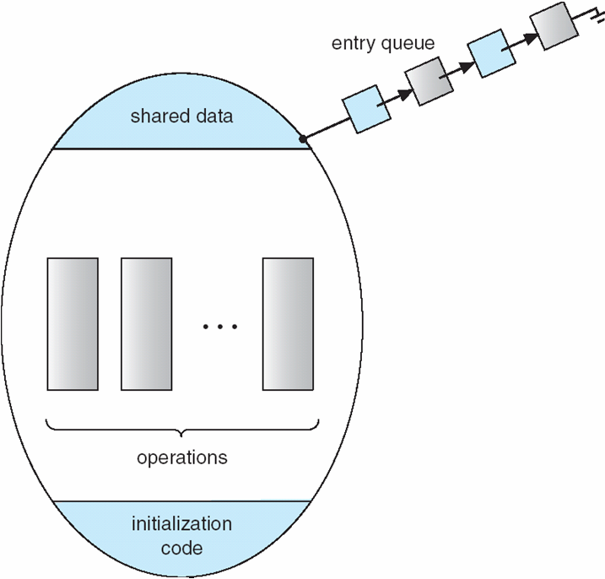
Schematic view of a Monitor

Slide 111
Condition Variables
Main idea:
make it possible for thread to sleep inside a critical section
Approach:
by atomically releasing lock, putting thread on wait queue and go to sleep
Each variable has a queue of waiting threads
threads that are sleeping, waiting for a condition

Slide 112
Condition Variables
condition x, y;
Two operations on a condition variable:
x.wait () – a process that invokes the operation is
suspended.
x.signal () – resumes one of processes (if any) that
invoked x.wait ()
Notes:
每个条件变量都需要在管程中说明
条件变量没有具体取值

Slide 113
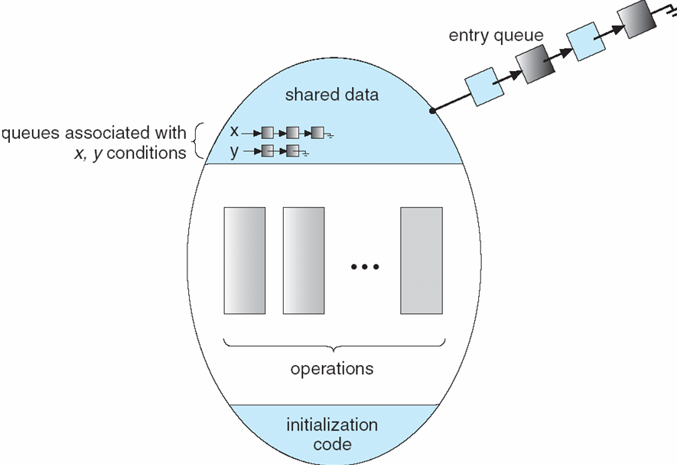
Monitor with Condition Variables

Slide 114
Producer Consumer using Monitors
Monitor Producer_Consumer {
any_t buf[N];
int n = 0, tail = 0, head = 0;
condition full, empty;
void put(char ch) {
if(n == N) empty.wait();
buf[head%N] = ch;
head++;
n++;
full.signal();
}
char get() {
if(n == 0) full.wait();
ch = buf[tail%N];
tail++;
n--;
empty.signal();
return ch;
}
}
What if no thread is waiting
when signal is called?
Signal is a “no-op” if nobody is waiting. This is very different from what happens when you call signal () on a semaphore – semaphores have a “memory” of how many times
signal() was called!
（信号量记录了有多少个需求没被满足）
Notes:
114
no-op:空操作

Slide 115
Producer Consumer using Monitors
producer : begin
repeat
produce an item in nextp ;
Producer_Consumer.put ( item) ;
until false ;
end
consumer : begin
repeat
Producer_Consumer.get (item) ;
consume the item in nextc ;
until false ;
end
Notes:
115

Slide 116
Solution to Dining Philosophers
monitor DP
{
enum { THINKING; HUNGRY, EATING } state [5] ;
condition self [5];
void pickup (int i) {
state[i] = HUNGRY;
test(i);
if (state[i] != EATING) self [i].wait;
}
void putdown (int i) {
state[i] = THINKING;
// test left and right neighbors
test((i + 4) % 5);
test((i + 1) % 5);
}

Slide 117
Solution to Dining Philosophers (cont)
void test (int i) {
if ( (state[(i + 4) % 5] != EATING) &&
(state[i] == HUNGRY) &&
(state[(i + 1) % 5] != EATING) ) {
state[i] = EATING ;
self[i].signal () ;
}
}
initialization_code() {
for (int i = 0; i < 5; i++)
state[i] = THINKING;
}
}

Slide 118
Solution to Dining Philosophers (cont)
Each philosopher I invokes the operations pickup()
and putdown() in the following sequence:
dp.pickup (i)
EAT
dp.putdown (i)

Slide 119
Monitor Implementation Using Semaphores
For a monitor, a semaphore mutex(initially = 1) is necessary to ensure mutual exclusion.
A process must execute wait(mutex) before entering the monitor, and execute signal(mutex) after leaving the monitor.
Another semaphore next(initially =0) is introduced for a signaling process to suspend itself until the signaled process leaves or waits.
Next-count is an integer variable to count the number of processes suspended on next.(有多少在等next)
Notes:
119

Slide 120
Monitor Implementation Using Semaphores
Variables
semaphore mutex; // (initially = 1)
semaphore next; // (initially = 0)
int next-count = 0;
Each procedure F will be replaced by
wait(mutex);
…
body of F;
…
if (next-count > 0)
signal(next)
else
signal(mutex);
Mutual exclusion within a monitor is ensured.

Slide 121
Monitor Implementation
因为唤醒了其他进程,则该进程需要等待直到被唤醒进程离开或等待为止
For each condition variable x, we have:
semaphore x-sem; // (initially = 0)
int x-count = 0;//表示因调用x.wait而等待的进程数
当前在管程中的进程因为资源不可用而等待,则需要唤醒一个进程进入管程
x.wait can be implemented as:
x-count++;
if (next-count > 0)
signal(next);
else
signal(mutex);
wait(x-sem);
x-count--;
x.signal can be implemented as: if (x-count > 0) {
next-count++;
signal(x-sem);
wait(next);
//只允许一个进程活动
next-count--;
}
Notes:
121
给每一个条件变量定义一个信号量
因管程中只允许一个进程活动,执行了signal的进程要进入等待状态, 这里用信号量wait(next)来实现, 整型变量Next-count表示在next等待的进程数

Slide 122
例题
如果有三个进程共享同一互斥段，而且每次最多允许两个进程进入该互斥段，则信号量的初值应设置为（ ）。
A. 3 B. 1 C. 2 D. 0
答案： C

Slide 123
例题
（ ）操作不是P操作可完成的。
A.为进程分配处理机 B.使信号量的值变小
C.可用于进程的同步 D.使进程进入阻塞状态
答案： A

Slide 124
例题
【多选】进程从执行状态转换到阻塞状态的可能原因是().
A.时间片完
B.需要等待其它进程的执行结果
C.执行了V操作
D.执行了P操作
答案： BD

Slide 125
例题
【解答题】设有两个优先级相同的进程P1和P2如下。信号量S1和S2的初值均为0，试问P1、P2并发执行结束后，x=?，y=?，z=?
〈进程P1〉 〈进程P2〉
y:=1; x:=1;
y:=y+2; x:=x+1;
V(S1); P(S1);
z:=y+1; x:=x+y;
P(S2)； V(S2)；
y:=z+y; z:=x+z;
答案：x=5，y=12，z=9或x=5，y=7，z=9
Notes:
因为P1和P2是两个并发进程，所以进程调度程序调度P1和P2的顺序是不确定的。
这里不妨假设P1先执行。进程P1执行到语句P(S2)时，S2＝-1，进程P1阻塞。此时，y=3，z=4。当进程调度程序调度到进程P2时，由于进程P1已执行了V(S1)，进程P2在执行P(S1)时并未阻塞而继续执行，当执行到V(S2)时，将P1唤醒，然后执行最后一个语句z:=x+z，此时x=5，z=9。当进程P1再次被调度时，继续执行P1的最后一个语句，此时y=12,最终结果是：x=5，y=12，z=9。

Slide 126
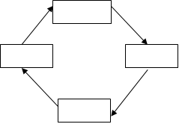
例题
【解答题】已知系统中有四个缓冲池M1，M2，M3，M4。其大小分别为3、2、3、2，各缓冲池分别存在0，1，0，2个缓冲区有数据。现同时有四个进程P1，P2，P3，P4分别在各缓冲区间不断地移动数据。见下图。例如，P1进程从M1向M2移动数据。试用信号量及其P、V（或signal,wait）操作及类Pasic/C语言描述各进程之间的同步关系，并给出各信号量的含义和初值。

Slide 127
Tips
互斥/同步的对象是谁？
互斥访问什么？
同步什么内容？
Notes:
127

Slide 128
例题
答案：
（1）互斥信号量和初值
m(1)=1,m(2)=1,m(3)=1,m(4)=1
（2）同步信号量
full(i) 表示buffer(i)是否有数据；
初值为 full(1)=0, full (2)=1, full (3)=0, full (4)=2；
empty(i)表示buffer(i)是否有空间；
初值为empty(1)=3, empty (2)=1, empty (3)=3, empty (4)=0、
（3）进程程序
process Proc(i)
{；
p(full(i))；
p(empty(i mod4 +1))
p(m(i) && m(imod4)+1));
move；
v(m(i) && m(i mod4)+1));
v(full((i mod4 +1)));
v(empty(i);
}

Slide 129
例题
【解答题】(2021统考真题)某银行提供2个服务窗口和10个供顾客等待的座位。顾客到达银行时，若有空座位，则到取号机上领取一个号，等待叫号。取号机每次仅允许一位顾客使用。当营业员空闲时，通过叫号选取一位顾客，并为其服务。
请添加必要的信号量和PC操作，实现上述过程。

Slide 130
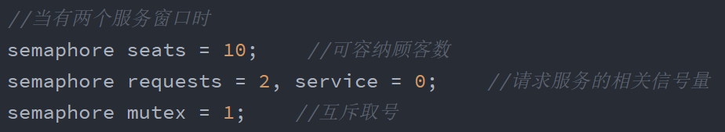
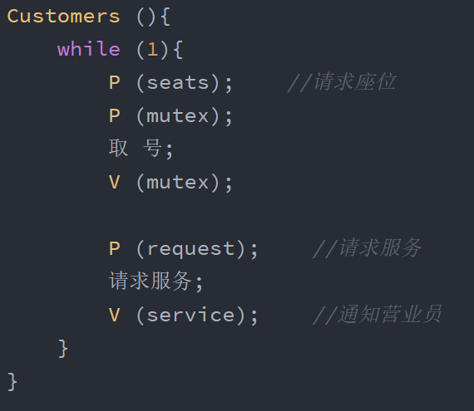
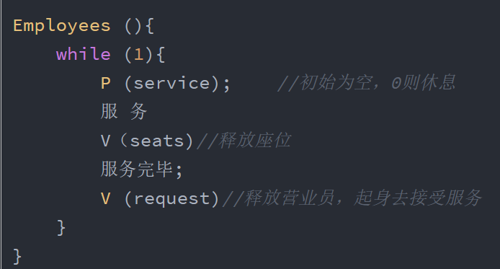
例题

Slide 131
例题
【解答题】理发店有1位理发师、1把理发椅和n把供等候理发的顾客坐的椅子。如果没有顾客，理发师便在理发椅上睡觉等第一个顾客到来。第一个顾客到来时，它必须叫醒理发师。如果理发师正在理发时又有顾客到来，则如果有空椅子可以坐，就坐下来等待，否则就离开。

Slide 132
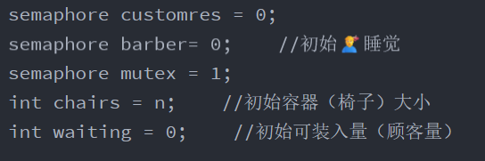
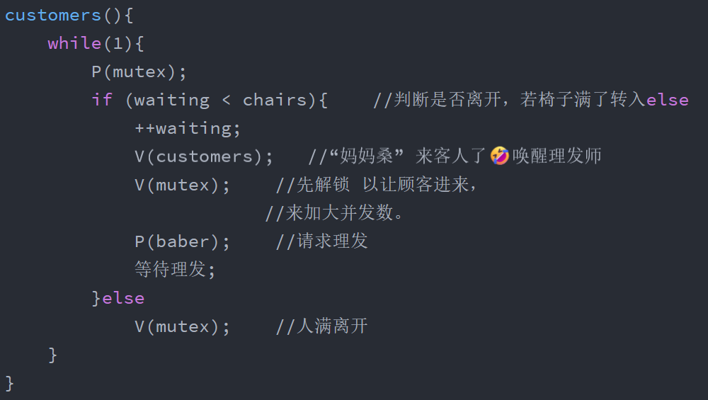
例题

Slide 133
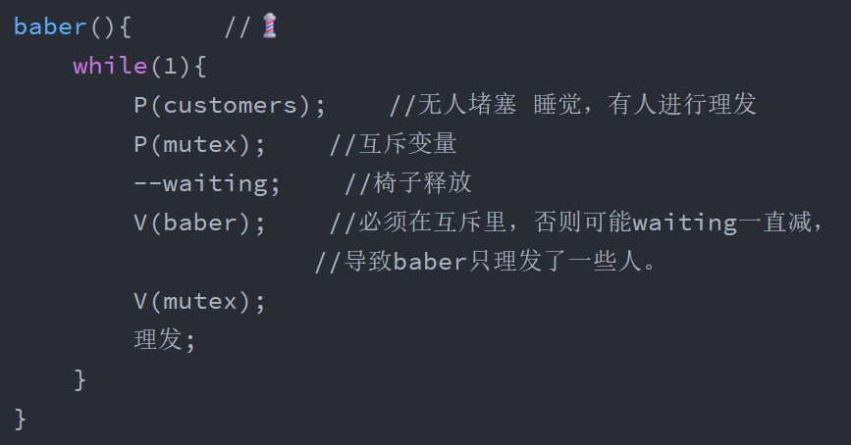
例题

Slide 134
Chapter 6: Process Synchronization
Background
The Critical-Section Problem
Peterson’s Solution
Synchronization Hardware
Semaphores
Classic Problems of Synchronization
Monitors
Synchronization Examples
Atomic Transactions

Slide 135
Synchronization Examples
Solaris
Windows XP
Linux
Pthreads
JAVA

Slide 136
Solaris Synchronization
Implements a variety of locks to support multitasking, multithreading (including real-time threads), and multiprocessing（实现各种锁以支持多任务、多线程(包括实时线程)和多处理）
Uses adaptive mutexes for efficiency when protecting data from short code segments.（在保护数据不受短代码段影响时，使用自适应互斥信号量提高效率）
Uses condition variables and readers-writers locks when longer sections of code need access to data.（当较长的代码段需要访问数据时，使用条件变量和读写锁）
Uses turnstiles（十字转门） to order the list of threads waiting to acquire either an adaptive mutex or a reader-writer lock.
Notes:
实现各种锁以支持多任务、多线程(包括实时线程)和多处理
在保护数据不受短代码段影响时，使用自适应互斥信号量提高效率。（长代码使用互斥信号量很低效）
当较长的代码段需要访问数据时，使用条件变量和读写锁。
使用十字转门对等待获取自适应互斥锁或读写锁的线程列表进行排序。

Slide 137
Solaris Synchronization
adaptive mutex is used to protect critical data
On a multiprocessor（多处理器） system
spinlock （自旋锁）
If the lock is held by a thread currently running on another CPU, the thread spins while waiting for the lock to become available
Not spin（非自旋锁）
If the thread holding the lock is not running, the thread blocks until the releasing of the lock.
On a single-processor（单处理器） system
The thread holding the lock is never running if the lock is tested by another thread, so threads always sleep rather than spin if they encounter a lock.（线程在遇到锁时总是休眠而不是旋转。）
Notes:
137
在单处理器系统上，自旋锁会浪费宝贵的CPU时间，而这个时间本可以用来做其他有用的工作（比如让另一个线程运行）。而在多处理器系统上，一个线程在自旋等待时，持有锁的线程可能正在另一个CPU上运行并很快释放锁。

Slide 138
Solaris Synchronization
Reader-writer locks（读写锁） are used to protect data that are accessed frequently but are usually accessed in a read-only manner.
More efficient than semaphore
Used on only long sections of code.
Notes:
138

Slide 139
Windows XP Synchronization
For kernel thread（内核线程）
单处理器：Uses interrupt masks（中断掩码） to protect access to global resources on uniprocessor systems
多处理器：Uses spinlocks（自旋锁） on multiprocessor systems
For user thread（用户线程）
provides dispatcher objects（调度对象） which may act as mutexes, semaphores and events
An event acts much like a condition variable（事件的作用很像条件变量）
An event may notify a waiting thread when a desired condition occurs. （事件发生可以通知等待的线程）
Notes:
对于内核线程
使用中断掩码(中断掩码)来保护对单处理器系统上全局资源的访问（中断掩码‌是一种用于控制中断处理的机制。它允许系统或设备在特定条件下暂时忽略某些中断请求，从而优化处理流程，避免不必要的处理开销。中断掩码通常用于硬件和软件层面，以控制中断的接收和处理）
在多处理器系统上使用自旋锁
对于用户线程
提供分派器对象(调度对象)，它可以作为互斥锁，信号量和事件 事件的作用很像条件变量
当期望的情况发生时，事件可以通知等待的线程。

Slide 140
Linux Synchronization
Prior to version 2.6, Linux was a nonpreemptive kernel（非抢占式内核）, meaning that a process running in kernel mode could not be peempted.（内核模式下运行的进程不能被抢占）
Now the Linux kernel is fully preempted.（现在Linux内核被完全抢占了）
Linux kernel provides:
Semaphores（信号量）
For single processor system（单处理器系统）
spin locks（自旋锁）
For SMP（对称多处理器系统）
Notes:
在2.6版本之前，Linux是一个非抢占式内核，这意味着在内核模式下运行的进程不能被抢占。
现在Linux内核被完全抢占了。
Linux内核提供: 信号量 对于单处理器系统
自旋锁 对于SMP（对称多处理系统）

Slide 141
Pthreads Synchronization
Pthreads API is OS-independent（API与操作系统无关）
It provides:
mutex locks（互斥锁）
To protect critical section of code（保护临界区）
condition variables（条件变量）
behave much as described in monitor（与管程中的描述大致相同）
read-write locks（读写锁）
Notes:
Pthreads API与操作系统无关
它提供:互斥锁
为了保护代码的临界区
条件变量
与管程中的描述大致相同 读写锁
不可移植扩展包括
信号量、自旋锁

Slide 142
Java Synchronization
Synchronized, wait(), notify() statements
Multiple Notifications（多通知）
Block Synchronization（块同步）
Java Semaphores
Notes:
142
Synchronized, wait()， notify()语句
多个通知
块同步
Java信号量

Slide 143
Java Synchronization
Synchronized statements（Synchronized声明）
Every object in JAVA has associated with it a single lock.
When a method is declared as synchronized, calling the method requires owning the lock for the object.（当一个方法声明为“synchronized”，那么调用这个方法就需要拥有该对象的锁）
Entry set:
the set of threads waiting for the lock to become available.（如果对象的锁已被别的线程拥有，那么调用同步方法的线程进入该对象锁的入口等待队列(entry set )中）
Notes:
143
在JAVA中，每个对象都与一把锁相关联。
当一个方法声明为“同步的”，那么调用这个方法就需要拥有该对象的锁。
如果对象的锁已被别的线程拥有，那么调用同步方法的线程进入该对象锁的入口等待队列(entry set )中。
当线程退出了同步方法时锁就会释放.

Slide 144
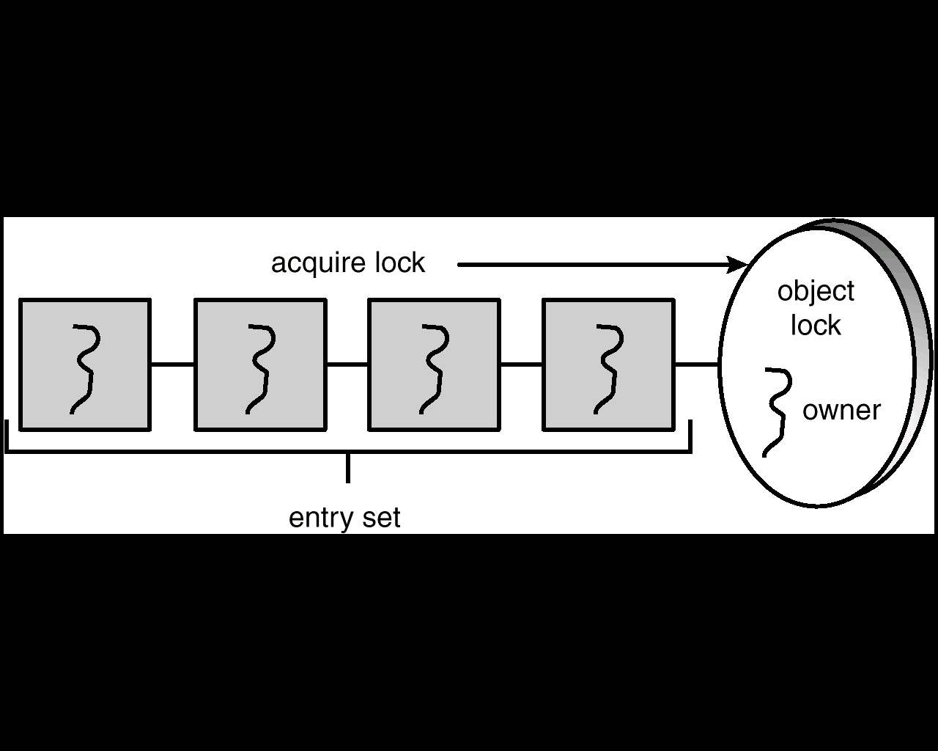
Entry Set

Slide 145
synchronized enter() Method
public synchronized void enter(Object item) {
while (count == BUFFER_SIZE)
Thread.yield();
++count;
buffer[in] = item;
in = (in + 1) % BUFFER_SIZE;
}

Slide 146
synchronized remove() Method
public synchronized Object remove() {
Object item;
while (count == 0)
Thread.yield();
--count;
item = buffer[out];
out = (out + 1) % BUFFER_SIZE;
return item;
}

Slide 147
Java Synchronization
Producer-consumer problem（生产者消费者问题）:
The object BoundedBuffer has one lock（对象BoundedBuffer有一个锁）
A producer must acquire the lock before invoking method enter().（生产者必须在调用方法之前获取锁）
When the lock is owned by a producer, if a consumer want to invoke remove(), it has to block until the producer exits the method enter() and release the lock. （当锁由生产者拥有时，如果消费者想要调用remove()，它必须阻塞，直到生产者退出方法enter()并释放锁）
Notes:
生产者消费者问题:
对象BoundedBuffer有一个锁
生产者必须在调用方法enter()之前获取锁。
当锁由生产者拥有时，如果消费者想要调用remove()，它必须阻塞，直到生产者退出方法enter()并释放锁。
这确保了相互排斥。

Slide 148
Java Synchronization
However, lock ownership has led to another problem.（锁所有权带来了另一个问题）
Assume that the buffer is full and the consumer is sleeping.（假设缓冲区已满，消费者处于睡眠状态）
If the producer calls enter(), it will be allowed to continue because the lock is available. When the producer invokes enter(), it sees a full buffer and performs the yield(), but it still owns the lock for the object.（如果生产者调用enter()，它将被允许继续，因为锁是可用的。当生产者调用enter()时，它看到一个满缓冲区并执行yield()，但它仍然拥有对象的锁）
When the consumer awakens and try to call remove(), it will block because it does not own the lock.（当消费者唤醒并尝试调用remove()时，它会阻塞，因为它不拥有锁）
This leads to deadlock.
Notes:
然而，锁所有权带来了另一个问题。
假设缓冲区已满，消费者处于睡眠状态。
如果生产者调用enter()，它将被允许继续，因为锁是可用的。当生产者调用enter()时，它看到一个满缓冲区并执行yield()，但它仍然拥有对象的锁。
当消费者唤醒并尝试调用remove()时，它会阻塞，因为它不拥有锁。
这会导致死锁。

Slide 149
Java Synchronization
Solution:
In addition to having a lock, every object also has a wait set.
Two new methods: wait() and notify().
If the producer calls enter() and the buffer is full, it will release the lock by invoking wait(), and enter to the wait set for the object.（如果生产者调用enter()并且缓冲区已满，它将通过调用wait()释放锁，并进入对象的等待集）
So the consumer can acquire the lock and call remove(), and then awake the producer by notify().（消费者可以获取锁并调用remove()，然后通过notify()唤醒生产者）
Notes:
解决方案:
除了拥有锁之外，每个对象还有一个等待集。 两个新方法:wait()和notify()。
如果生产者调用enter()并且缓冲区已满，它将通过调用wait()释放锁，并进入对象的等待集。
因此，消费者可以获取锁并调用remove()，然后通过notify()唤醒生产者。

Slide 150
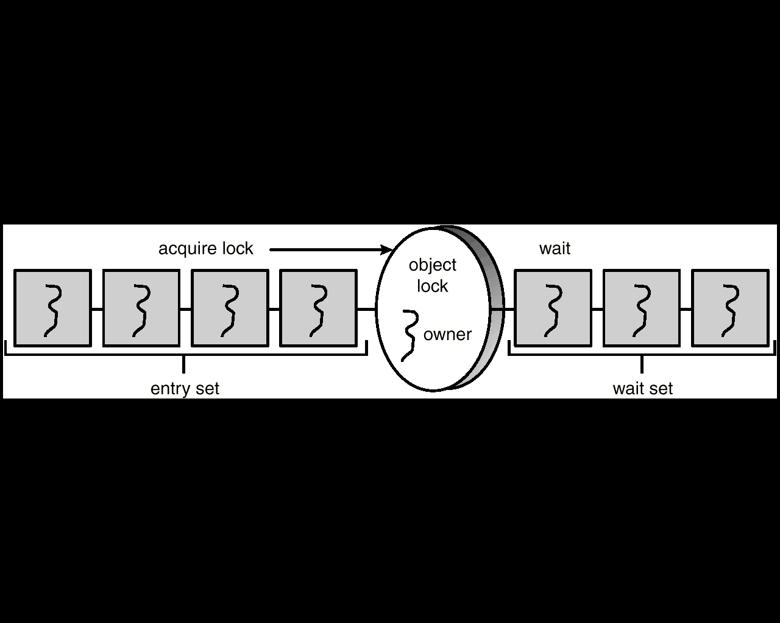
Entry and Wait Sets

Slide 151
Entry Set

Slide 152
The wait() Method
When a thread calls wait(), the following occurs:
- the thread releases the object lock.（线程释放锁）
- thread state is set to blocked.（线程阻塞）
- thread is placed in the wait set（放入等待集）

Slide 153
The notify() Method
When a thread calls notify(), the following occurs:
- selects an arbitrary thread T from the wait set（在等待集选择随便一个线程T）
- moves T to the entry set.（将它挪入进入集）
- sets T to Runnable.（将它设为就绪）
T can now compete for the object’s lock again（该线程能够继续竞争锁）

Slide 154
Multiple Notifications
notify() selects an arbitrary thread T from the wait set
If there are multiple threads in wait set and more than one condition for which to wait, it is possible to have another deadlock.（如果等待集中有多个线程，并且需要等待的条件不止一个，则可能再次发生死锁）
例：有5个线程T1，T2，T3，T4，T5，一个共享变量turn，5个线程都需要调用dowork()方法，规定只有编号与turn相同的线程才能进入dowork()。假定turn=3， T1，T2，T4在等待集中， T3在调用dowork()。当T3完成了它的工作，它把turn设为4，并调用notify()。 notify()从等待集中任意选取一个线程，假设选中了T2，但当T2恢复运行后检查条件时，发现turn并不是它的值，于是T2再次调用wait(),进入等待集。接下来，如果T3，T5调用dowork()，也会进入等待集。这样，5个线程都进入了等待集，形成了死锁。

Slide 155
Multiple Notifications
notify() selects an arbitrary thread from the wait set. This may not be the thread that you want to be selected.（可能没选择合适的thread）
notifyAll() removes ALL threads from the wait set and places them in the entry set. This allows the threads to decide among themselves who should proceed next.（把所有等待集中的线程放入进入集）
Notes:
155

Slide 156
The Readers-Writers Problem
JAVA solution to reader-writer problem：
readerCount： number of readers
dbReading： is set to true if the database is currently being read
dbWriting： is set to true if the database is currently being written
startRead()、endRead ()、startWrite ()、endWritet (): are all declared as synchronized to ensure mutual exclusion for the shared variables.

Slide 157
Reader Methods with Java Synchronization
public class Database {
public Database() {
readerCount = 0;
dbReading = false;
dbWriting = false;
}
public synchronized int startRead() { /* see next slides */ }
public synchronized int endRead() { /* see next slides */ }
public synchronized void startWrite() { /* see next slides */ }
public synchronized void endWrite() { /* see next slides */ }
private int readerCount;
private boolean dbReading;
private boolean dbWriting;
}

Slide 158
Writer Methods
public void synchronized startWrite() {
while (dbReading == true || dbWriting == true)
try {
wait();
}
catch (InterruptedException e) { }
dbWriting = true;
}
public void synchronized endWrite() {
dbWriting = false;
notifyAll();
}

Slide 159
startRead() Method
public synchronized int startRead() {
while (dbWriting == true) {
try {
wait();
}
catch (InterruptedException e) { }
}
++readerCount;
if (readerCount == 1)
dbReading = true;
return readerCount;
}

Slide 160
endRead() Method
public synchronized int endRead() {
--readerCount
if (readerCount == 0)
dbReading = false;
notifyAll();
return readerCount;
}

Slide 161
Block Synchronization
Blocks of code – rather than entire methods – may be declared as synchronized（可以将代码块——而不是整个方法——声明为同步的）
This yields a lock scope that is typically smaller than a synchronized method（这产生的锁范围通常比同步方法小）
Object mutexLock = new Object();
. . .
public void someMethod() {
// non-critical section
synchronized(mutexLock) {
// critical section
}
// non-critical section
}
Notes:
161

Slide 162
Java Semaphores
Java does not provide a semaphore, but a basic semaphore can be constructed using Java synchronization mechanism（Java不提供信号量，但是可以使用Java同步机制构造基本的信号量）
Notes:
162

Slide 163
Semaphore Class
public class Semaphore {
public Semaphore() {
value = 0;
}
public Semaphore(int v) {
value = v;
}
public synchronized void P() { /* see next slide */ }
public synchronized void V() { /* see next slide */ }
private int value;
}

Slide 164
P() Operation
public synchronized void P() {
while (value <= 0) {
try {
wait();
}
catch (InterruptedException e) { }
}
value --;
}

Slide 165
V() Operation
public synchronized void V() {
++value;
notify();
}

Slide 166
Java Synchronization rules
a thread that owns the lock for an object can enter another synchronized method for the same object. （拥有对象锁的线程可以进入同一对象另一个同步方法）
a thread can nest synchronized method invocations for different objects. thus, a thread can simultaneously own the lock for several different objects（线程可以嵌套不同对象的同步方法调用。因此，一个线程可以同时拥有几个不同对象的锁）
Notes:
拥有对象锁的线程可以为同一对象进入另一个同步方法。
线程可以嵌套不同对象的同步方法调用。因此，一个线程可以同时拥有几个不同对象的锁

Slide 167
Java Synchronization rules(Cont.)
if a method is not declared as synchronized, then it can be invoked regardless of lock ownership, even while another synchronized method for the same object is executing.（如果一个方法没有被声明为synchronized的，那么不管锁的所有权如何，它都可以被调用，即使是在同一对象的另一个同步方法正在执行的时候。）
if the wait set for an object is empty, then a call to notify() or notifyall() has no effect.（如果对象的等待集为空，则调用notify（）或notifyall（）不起作用）
Notes:
如果一个方法没有被声明为同步的，那么不管锁的所有权如何，它都可以被调用，即使是在同一对象的另一个同步方法正在执行的时候。
如果对象的等待集为空，则调用notify()或notifyall()不起作用。

Slide 168
例题
为什么在单处理器系统上通过禁止中断来实现同步原语的方法不适用于用户级程序？
Explain why implementing synchronization primitives by disabling interrupts is not appropriate in a single-processor system if the synchronization primitives are to be used in user-level programs.
答：
如果用户程序禁止了中断，这个用户程序将永久霸占CPU，在单处理器系统上会使得整个系统崩溃

Slide 169
例题
进程的同步与互斥是由于程序的（ ）引起的：
A 顺序执行
B 长短不同
C 信号量
D 并发执行
答案：D

Slide 170
例题
自旋锁为什么不适用于单处理器系统，但在多处理器系统上经常用？
Explain why spinlocks are not appropriate for single-processor systems yet are often used in multiprocessor systems.
答：
在单处理器上，线程的自旋会一直占用着唯一的CPU。
而多处理器有多个CPU，自旋不会阻塞锁的持有者

Slide 171
例题
与管程相关的signal（）操作与为信号量定义的相应操作有何不同？
How does the signal() operation associated with monitors differ from the corresponding operation deﬁned for semaphores?
答：管程包括一个条件变量和其对应的等待队列
信号量的 signal() 是“累积的”，它会改变信号量的状态（增加计数值），这个状态变化是持久的，即使当时没有线程在等待。
管程的 signal() 是“非累积的”，它更像一个通知。如果发出通知时没有线程在条件变量上等待，那么这个通知就丢失了，不会产生任何效果。

Slide 172
End of Chapter 6

